Slide 1
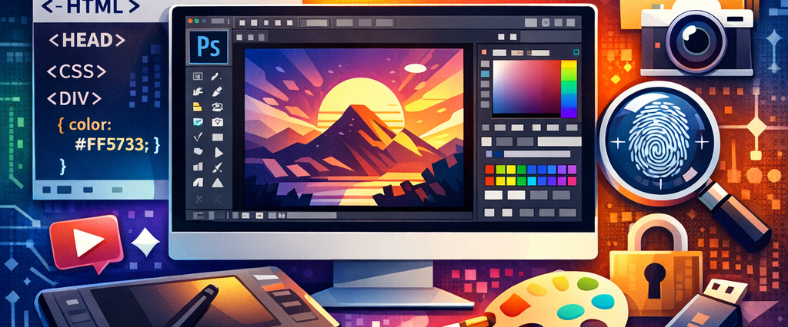
The World Wide Web and Internet
The internet really is everywhere – and it’s here to stay. What’s really great about the Internet is that is takes only a couple of hours to learn.
Notes:
Digital Media Design

Slide 2
Learning outcome:
Define the relationship among website, website address, Domain Name, web page, and Uniform Resource Locator (URL)
Explain how to interpret the parts of an address on the web.
Identify the major components and features of web browser software.
Describe the differences between directory and true search engines.
Describe the various technologies that make up the internet.
Identify key considerations in choosing an internet service provider (ISP)
Describe the communications software and telecommunications hardware you need to connect to the internet.
Notes:
Digital Media Design

Slide 3

Topics:
World Wide Web
Websites, Addresses, and Pages.
Understanding address.
Using Web Browser Software.
Search Engine.
Using a True Search Engine.
Internet Servers
Using a Web Portal
Connecting to the Internet.
Communications Software.
Telecommunications Hardware
Notes:
Digital Media Desidn

Slide 4

Assignments
Quiz and Exercises

Slide 5
Thank you
Notes:
Digital Media Design

